Slide 1
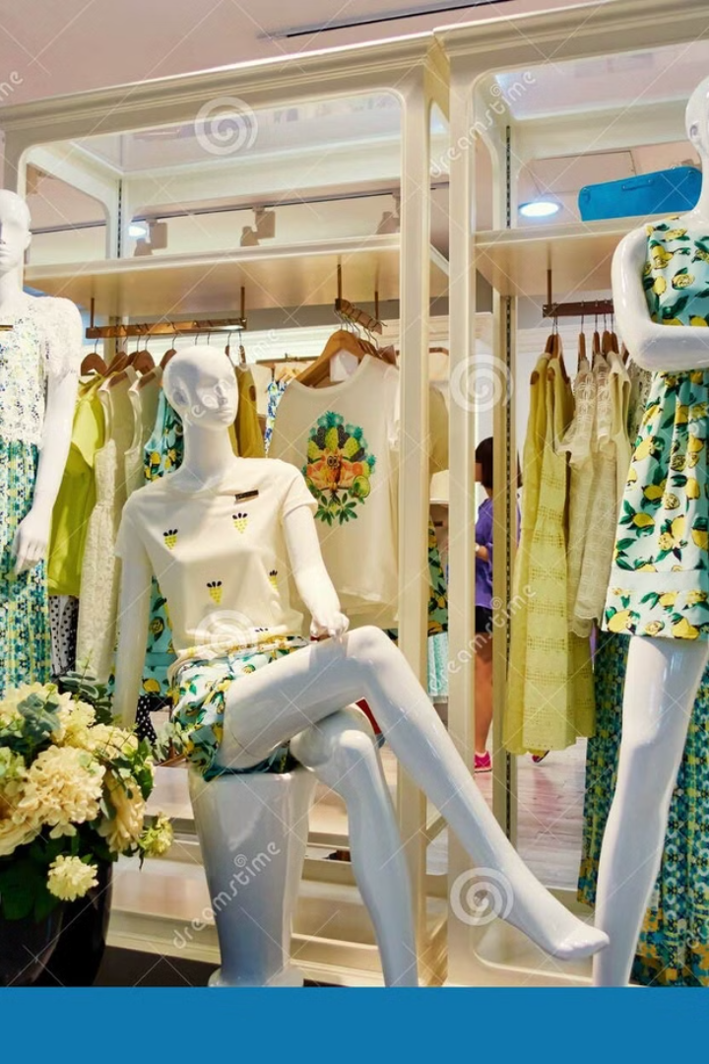
Image-Based Recommendation System: Leveraging Pre-Trained Models
Team Member’s :
Eldho Alias
Bharat
Varsini
Sakshi
Monish
Guided by : Anil Shaw

Slide 2
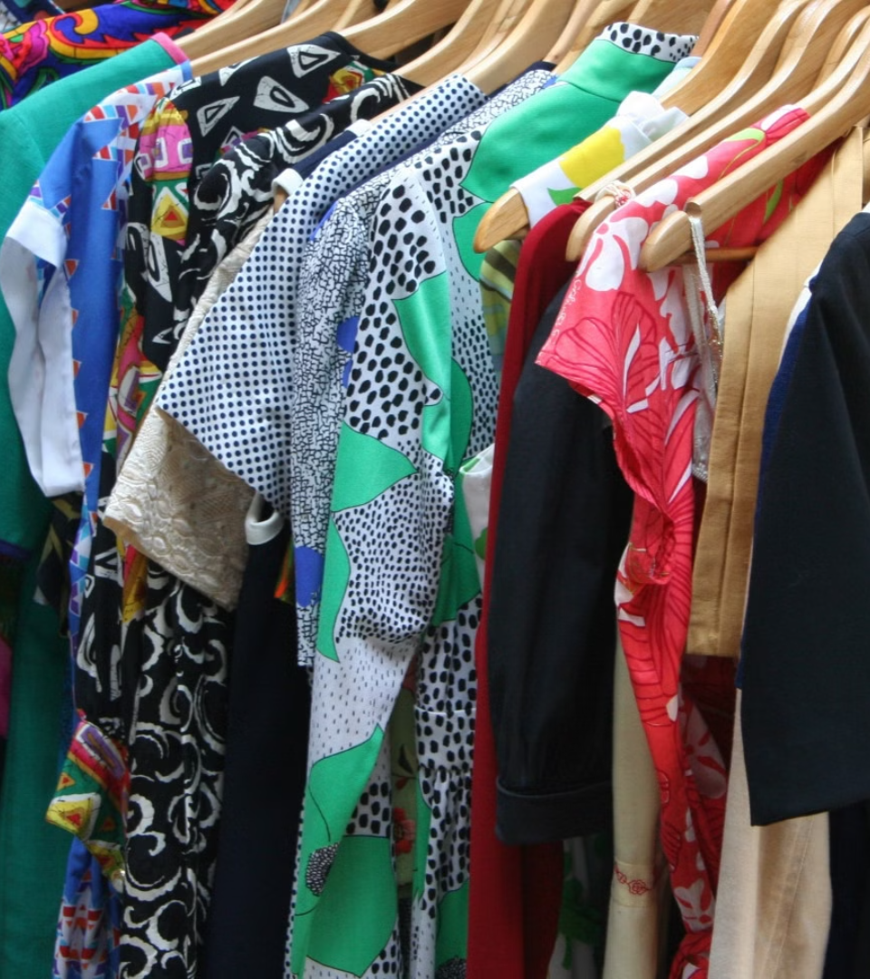
CONTENT
Introduction
Overview of AI in Fashion
Preprocessing Techniques
Recommendation Systems
Personalized Recommendation
Computing Cosine Similarity
Pre-trained Models
Feature Extraction for Generating image Embeddings
Evaluating Recommendation Accuracy

Slide 3
The Transformative Power of AI in Fashion
Overview of Al in Fashion:
Al technologies like machine learning, deep learning, and natural language processing are transforming the fashion industry by enabling personalized experiences. Recommender systems in fashion e-commerce predict user preferences, enhancing user experience and boosting sales.Personalized Experiences
Importance of Recommendation Systems in the Industry:
Recommender systems use collaborative filtering (user-llem Interactions) and content-based filtering (item features) to make personalized predictions. Hybrid models, which combine both methods, offer more accurate recommendations by leveraging user interaction data and item metadata.

Slide 4
Building the Image-Based Recommendation System
Step 1: Data Collection and Preprocessing
1
Gather a diverse dataset of clothing images and associated metadata.
2
Step 2: Pre-trained Model Selection
Choose a suitable pre-trained model like VGG16, MobileNet, or ResNet.
Step 3: Feature Extraction
3
Generate image embeddings representing visual features.
4
Step 4: Similarity Calculation
Compute cosine similarity between image embeddings to measure outfit similarity.
Step 5: Recommendation Generation
5
Rank potential outfit combinations based on similarity and present top recommendations.

Slide 5

Recommendation Systems
1
Collaborative Filtering
2
Content-Based Filtering
Recommends items based on user-item interactions.
Predicts user preferences based on item features.
Personalized Styling: Recommends outfits based on user preferences and similar users' choices.
Personalized Recommendations: Suggests outfits based on the user's past choices and preferences.
Trend Identification: Discovers popular fashion patterns among like-minded users.
Feature Matching: Compares product attributes like color, style, and category to user preferences.

Slide 6





Personalized Recommendations
1
User Preferences
2
Past Interactions
3
User Similarity
4
Recommendation Generation
5
Enhanced User Experience

Slide 7
Computing Cosine Similarity on Image Embeddings
Image Embeddings
Cosine Similarity
Recommendation
Representations of visual features of an outfit, generated by the pre-trained model.
Measures the angle between two image embeddings, indicating how similar the outfits are.
Generate outfit recommendations based on cosine similarity scores, presenting similar outfits to the user's preferences.

Slide 8

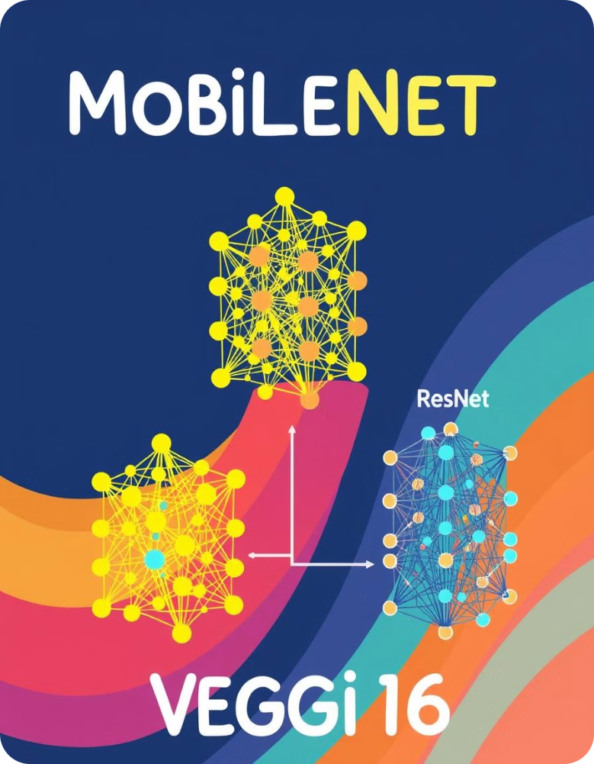
Methodology: Pre-trained Models Used
VGG16
MobileNet
A deep convolutional neural network known for its powerful image classification abilities.
A lightweight model optimized for mobile devices, offering fast and efficient image processing.
ResNet
A powerful model using residual connections to improve training performance and handle deeper networks.

Slide 9
Feature Extraction: Generating Image Embeddings
Image Input
1
Pass a clothing image through the pre-trained model.
Convolutional Layers
2
Extract features like edges, textures, and shapes.
Pooling Layers
3
Reduce the spatial dimensions of the feature maps, retaining important information.
Fully Connected Layers
4
Combine extracted features into a final representation, the image embedding.

Slide 10




Evaluating Recommendation Accuracy
Cosine Similarity
Feature Embedding Analysis
Top-N Accuracy
Measures the closeness between image embeddings to ensure precise recommendations.
Visual inspection of extracted embeddings to verify meaningful grouping of similar items.
Evaluates if the correct recommendations appear within the top results displayed to users.
Cross-Model Comparison
Results from VGG16, MobileNet, and ResNet are compared to identify the most effective model for accurate predictions.

Slide 11
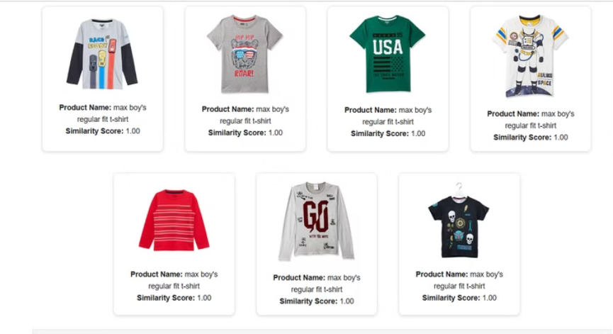
Results : Results of the Recommendation.

Slide 12
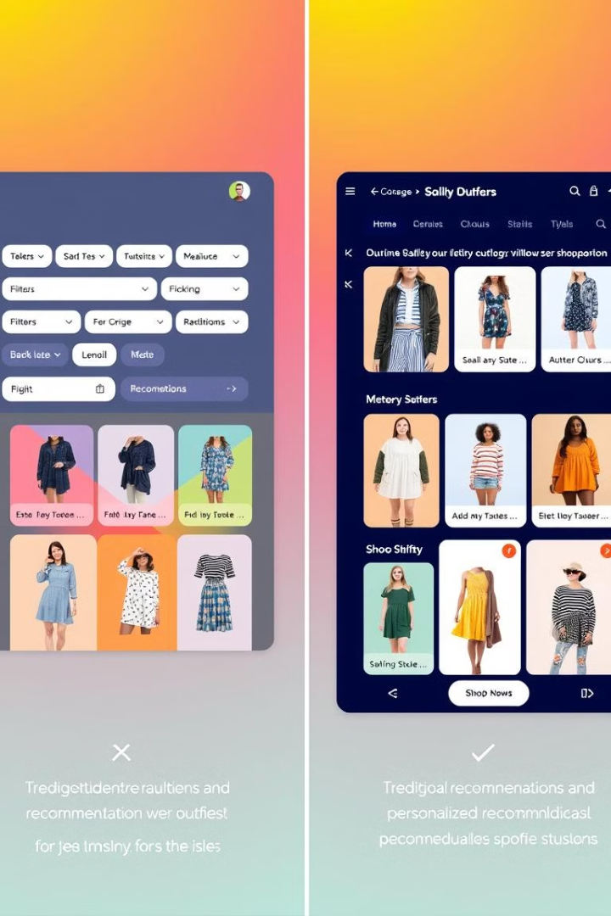
Future Scope
1
2
Real-Time Recommendations
Trend Prediction
Using time-series analysis to predict future fashion tre
Optimizing the system to provide instant recommendations during online shopping.

Slide 13
THANK YOU !

